Slide 1

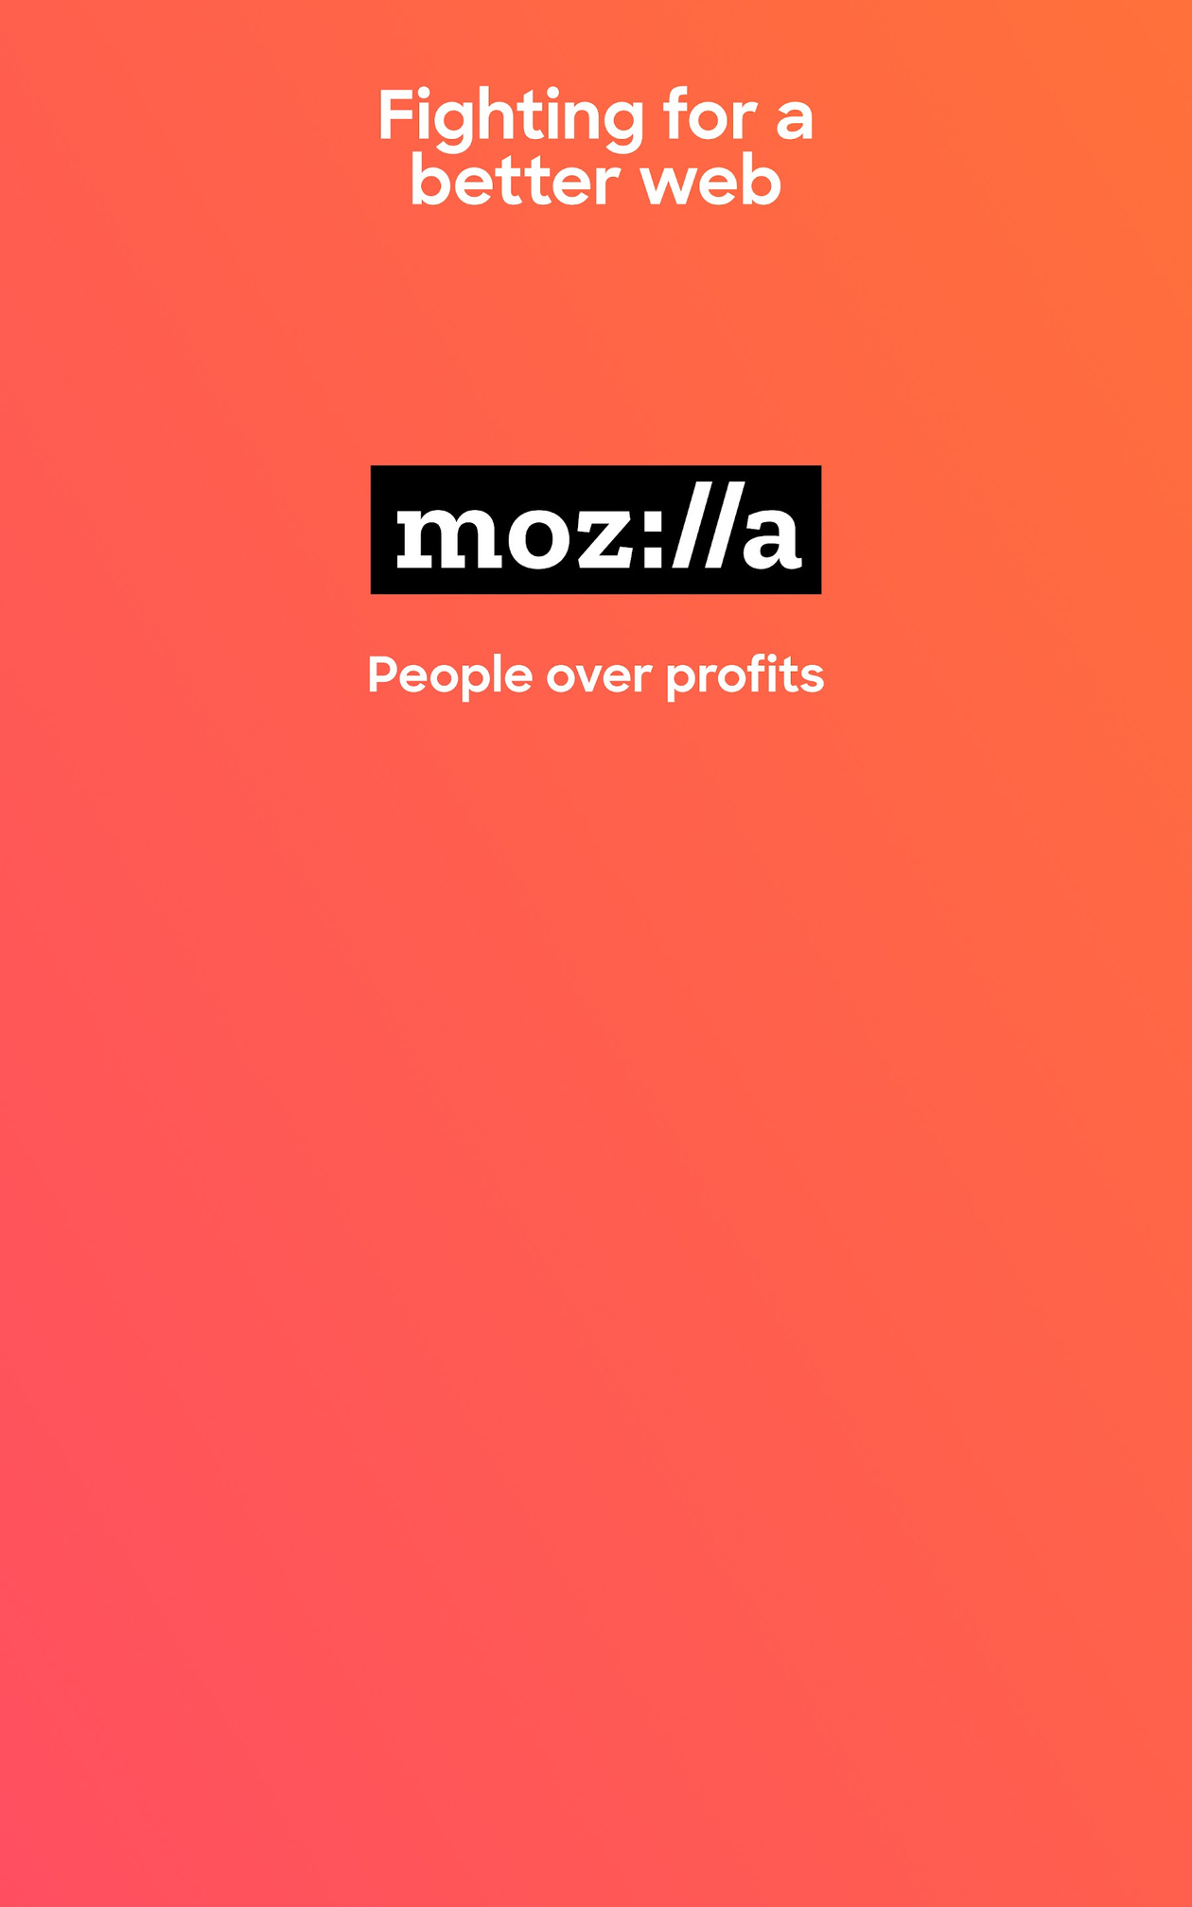

the group2B: Mozilla Foundation

Slide 2




Organisation History
March 31st, 1998
March, 2006
Mozilla Organisation is born [1]
Strategic Partnership with Google for default search engine
July 15th, 2003
March 18th, 2006
AOL scraps Netscape Involvement, Mozilla Foundation is born
Mozilla Developer Network (MDN) is formed
July 28th, 2003
September, 2008
Thunderbird Email Client launched
Google Chrome is launched - 66% of current market
November 9th, 2004
Firefox Browser is launched
March 29th, 2011
Mozilla Mobile Web Browser is released to public
August 3rd, 2005
Mozilla Corporation (subsidiary for all financial activities)
June 16th, 2011
Mozilla Reps [2]

Slide 3


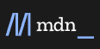


Structural Evolution
Aug 2005
Future Readiness
Marketing/
Outreach
Developer Outreach Program
MDN
Durable Team
(Part of Emerging
Technologies)
(Content team - July 2017, Dev Team - Mar 2018)

Slide 4
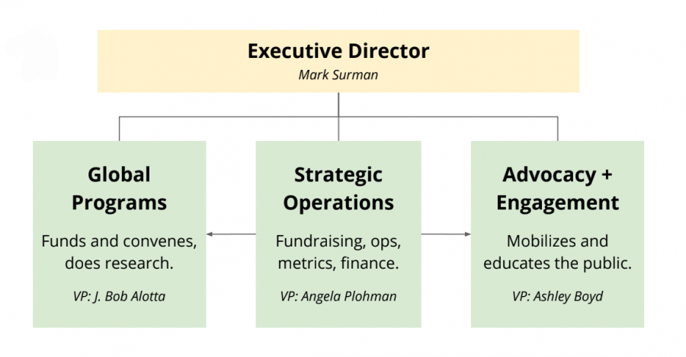
Representative Structure
Mozilla Foundation has a Functional Structure
This allows for efficient communication and collaboration between team members

Slide 5
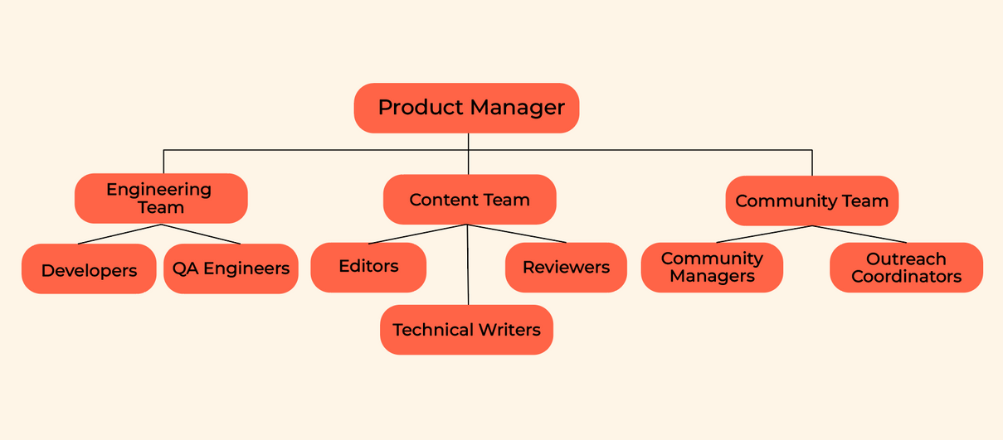
Mozilla Developer Network
Structure - Core
MDN Durable Team - made of developers, writers, and editors responsible for maintaining & improving the MDN, led by Product Manager - Kadir Topal

Slide 6
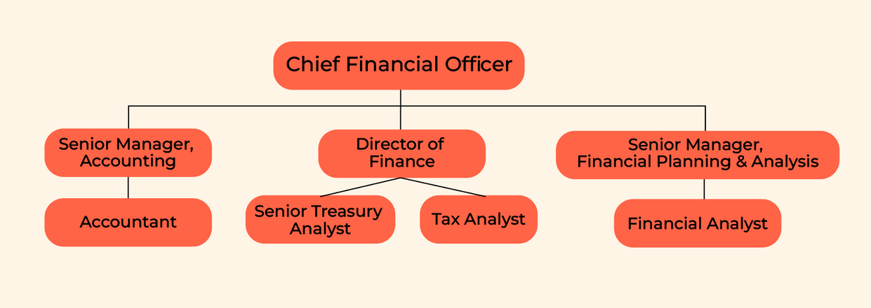
Mozilla Finance Team Structure - Non-Core
The team is led by the Chief Financial Officer, Eric Muhlheim.

Slide 7
Organisation Culture
Mozilla follows a Communal Organisation culture
High Sociability (Volunteer Engagment by Mozilla Reps)
High Solidarity (There's a collective strategic focus, towards dismantaling the hegemony of Big Tech)
However, there are elements like the volunteer developers, where we see elements of Mercenary culture
The MDN Docs are well documented to allow people to contribute, even without having non-instrumental ties between members
COMMUNAL
MOZILLA
NETWORKED
Sociability
FRAGMENTED
MERCENERY
Solidarity

Slide 8
Organisation Culture
Needs of the Environment
Flexibility
Stability
Adaptability
Culture
Mission
Culture
External
Strategic Focus
Clan
Culture
Bureaucratic
Culture
Internal

Slide 9
Culture Building Activities
Rites & Ceremonies
Moz Fest
"Arrive with an idea, leave with a community"
Building A Learning Community | Education & Access Wranglers
It is a part art, tech, and society convening, part maker festival, and the premiere gathering for activists in diverse global movements fighting for a more humane digital world.
Mozilla Global Sprint
"Giant distributed open source hackathon"
It’s an international public event: an opportunity for anyone, anywhere to energize their open-source projects with fresh insight and input from around the world. In years past, hundreds of individuals in more than 35 cities have participated in the Global Sprint.

Slide 10

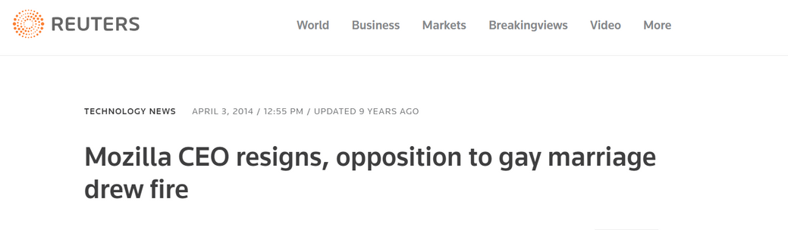
Culture Building Activities
2. Symbols
Crop Circle
Weather Balloon: Celebrating the 100M downloads of Firefox
3 . Community Values
The Community Values driving culture at Mozilla

Slide 11
Key Differentiation Factors
Embracing Open Source Philosophy:
Commitment to open source software principles
Open access to source code: Collaboration, transparency, and Community Engagement
Prioritizing Privacy and Security:
Strong focus on user privacy and security
Innovative features to enhance control and block unwanted tracking
Thriving Community Engagement:
Active involvement of volunteers, developers, and contributors
Community-driven development, fostering innovation
Nonprofit Mission:
Operating as a nonprofit organization
Commitment to advancing an open and accessible internet over profit

Slide 12
Educational Initiatives and Advocacy:
Empowering internet literacy, digital skills and online safety
Advocacy for policies nurturing an open internet ecosystem
Seamless Cross-Platform Support:
Projects designed for various operating systems
Firefox browser's compatibility with Windows, macOS, Linux, and mobile platforms
Cultivating Innovation and Experimentation:
Willingness to explore new ideas and technologies
Showcased through Mozilla Developer Network (MDN) and Firefox Test Pilot
Collaborative Corporate Partnerships:
Collaborations with companies supporting Mozilla's mission
Generating revenue via strategic partnerships, e.g., Firefox's search engine alliances

Slide 13
Competitive Strategies
Adopting a Differentiation strategy, but being a non-profit attacts a differentiated volunteer base, alongside braver products
At a glance, Mozilla looks like a classic Prospector, continually focusing on exploration and innovation
But Evaluate it on the Exploration and Exploitation tactics instead
Exploration
Investing into newer technologies, instead of just focusing in-house
Focus on user privacy, more powerful and immersive web, and accessibility features for PwD and Learning Disabiliies
Pivoting to mobile app, and now AI, quickly responding to market demand
Exploitation
Leveraging the voice of the Mozilla Community to push for activism dev
Moz Reps managing functional local structures
Module Owners structure leading to decentralization of product teams
Market share advantage leading to funding from big corps like Google

Slide 14
Arriving on a Strategy
Strategy for Mozilla dictated strongly by its Vision for the Evolution of the Web [10], the Mozilla Manifesto [11]and Mission [12] [13]
Based primarily on three basic values: Openness, Agency and Safety
These values have evolved into specific tasks, that Mozilla has adopted for its future, some notable ones including
Protecting User Privacy & Security
Extended the Web...Safely
Making the web fast enough for anyone to use
Improve accessibility for disabilities, and non-English speakers
Short-term strategy, focuses on fueling an emerging movement of users standing and fighting for a healthy internet [14]
Majority of Mozilla is building work focused on developing trustworthy AI
Deliberations that the community conducts on framing
Exploration over questions: What do we mean by trustworthy AI? etc.
Vocal dissent also available, AI is an expensive endeavor
In the event, when a clear path isn't available - we look to the decision making process

Slide 15
Decision Making
The entire story so far, has been of a community of millions that donate their time, money and brainpower to make the internet better [15]
Decision making is governed by a virtual management team of experts from various parts of the community
Some of them with leadership roles, but others are not
Granted to individuals based on how active they are in the community
Along with nature and quality of contribution
Mozilla Reps Mentors, Reps Council and Stewards
Ultimate Decision Maker, the "benevolent dictator" - traditionally been two people - currently only one, Mitchell Baker since 1999, current CEO & Chairwoman Mozilla Foundation [16]
Ex - Early days of Mozilla, the Google arrangement, "there weren't any models for this, so we created our own" - today the MoCo has a strong focus on running business well [17]
Experimenting with new frameworks - applying Ostrom's Principles to Data Commons Governance [18]

Slide 16
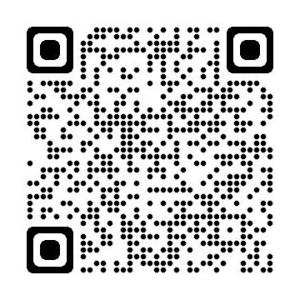
Questions?
Group 2:
Aditya Vardhan Gundla
Sidharth MK
Niti Pradhnya
Pavani Pennada
Karishma Verma
Harshvardhan Singh
Contribute to the Mozilla Community

Slide 17
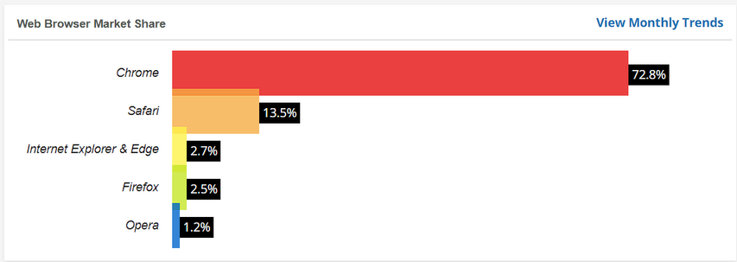
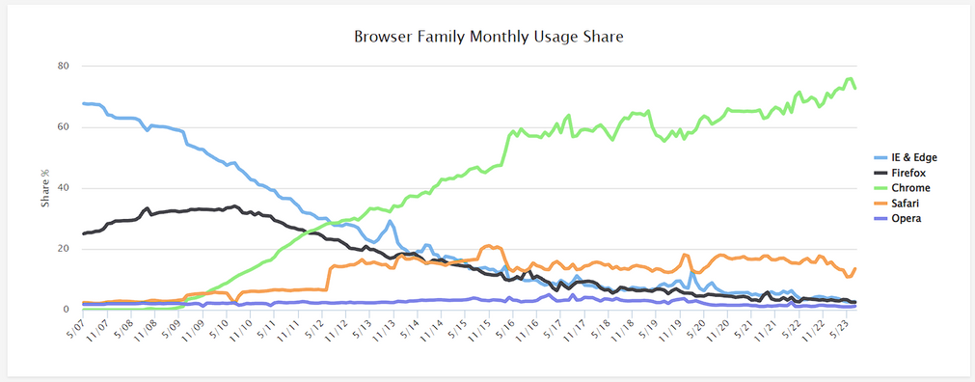
Appendix - 1
Figure 1: Current Broswer Market Share - ~3% for Firefox
Source 1,2: https://www.w3counter.com/globalstats.php
Figure 2: Browser Share for Firefox declining over time

Slide 18
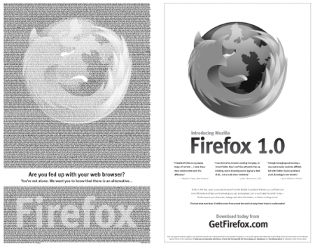
Appendix - 2
Figure 3: Firefox release ad

Slide 19
References 1/2
[1] The Mozilla Project Begins March 31st 1998: https://blog.mozilla.org/community/2013/04/15/milestone-the-mozilla-project-begins/
[2] Mozilla 10 year anniversary celebration: https://blog.mozilla.org/en/mozilla/news/reps-mozilla-community-10-year-celebration/
Structure
[3] MDN Structure:
MDN Web Docs: https://developer.mozilla.org/en-US/docs/MDN/About MDN Web Docs website.
MDN Product Advisory Board: https://developer.mozilla.org/en-US/docs/MDN/MDN_Product_Advisory_Board MDN Product Advisory Board website.
MDN Roles and Teams: https://developer.mozilla.org/en-US/docs/MDN/Community/Roles_teams MDN Roles and Teams website.
[4] Finance Team Structure:
Senior Treasury & Tax Compliance Analyst: https://www.workingnomads.com/jobs/senior-tax-and-treasury-analyst-mozilla job posting on Working Nomads.
https://assets.mozilla.net/annualreport/2021/mozilla-fdn-2021-fs-final-1010.pdf
[5] Mozilla Foundation Structure: https://wiki.mozilla.org/Foundation
Culture
[6] https://blog.mozilla.org/en/mozilla/news/mozillas-giant-distributed-open-source-hackathon/
[7] https://www.mozillafestival.org/en/

Slide 20
References 2/2
Culture
[8] https://firefoxcropcircle.com/circle/
[9] https://foundation.mozilla.org/en/blog/building-a-learning-community-education-access-wranglers/
Building a Strategy
[10] Vision for Evolution: https://www.mozilla.org/en-US/about/webvision/full/
[11] Mozilla Manifesto: https://www.mozilla.org/en-US/about/manifesto/
[12] Misson Statement: https://www.mozilla.org/en-US/mission/
[13] Clarification on the Mozilla Decision Making Process: https://blog.lizardwrangler.com/2010/12/20/mozilla-decision-making-process/
[14] Strategy at Mozilla: https://foundation.mozilla.org/en/who-we-are/strategy/
Decision Making
[15] https://www.mozilla.org/en-US/foundation/annualreport/2021/
[16] https://www.mozilla.org/en-US/about/governance/roles/
[17] https://www.mozilla.org/en-US/foundation/annualreport/2021/article/mitchell-baker/
[18] https://foundation.mozilla.org/en/blog/a-practical-framework-for-applying-ostroms-principles-to-data-commons-governance/

